Slide 1
Chapter 6 non-linear discriminant function and neighbor classifier
Chapter 5: Non-linear discriminant method and BPNN
Non-linear discriminant method
Back propagation neural network

Slide 2
5.1. Non-linear discriminant method
1. Introduction of Non-linear discriminant method
2. Piecewise Linear Discriminant method
3. Quadratic discriminant method

Slide 3

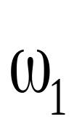
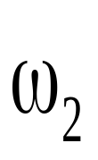
5.1.1. Non-linear discriminant method
Using linear discriminant method can not achieve satisfactory classification results for two types of objects in two-dimensional feature space as shown in the following figure.

Slide 4
5.1.1. Non-linear discriminant function
To achieve satisfactory classification results, non-linear discriminant method is here used.
Piecewise Linear Discriminant method
Quadratic discriminant method

Slide 5
5.1. Non-linear discriminant method
1. Introduction of Non-linear discriminant method
2. Piecewise Linear Discriminant method
  Distance Based Piecewise Linear Discriminant method
  Function Based Piecewise Linear Discriminant method
3. Quadratic discriminant method

Slide 6
5.1.2. Distance Based Piecewise Linear Discriminant method
The basic idea:
  Selecting the mean of each classification as the corresponding representative point;
  For each test point, computing its distance to all of the representative points;
  Determining the classification of each test point based on the minimum distance.
  Note: Obviously this method of identification is only efficient in densely distributed feature space, and in the region near the mean.

Slide 7
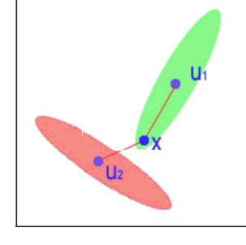
5.1.2. Distance Based Piecewise Linear Discriminant method
This identification method may fail in the non-intensive feature space, as shown below example.
ω₁
ω₂
If classifying X according to the principle of minimum distance, it will be classified into ω₂ rather than ω₁.
In this case,ω₁ should be further divided into sub-classes to achieve good classification results.

Slide 8
5.1. Non-linear discriminant method
1. Introduction of Non-linear discriminant method
2. Piecewise Linear Discriminant method
  Distance Based Piecewise Linear Discriminant method
  Function Based Piecewise Linear Discriminant method
3. Quadratic discriminant method

Slide 9

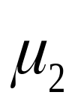



5.1.2. Function Based Piecewise Linear Discriminant method

Slide 10
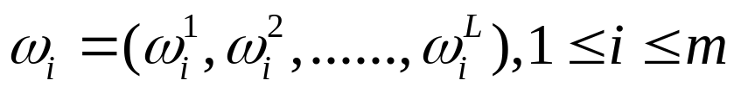
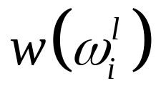
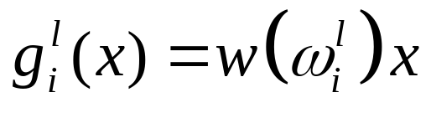
5.1.2. Function Based Piecewise Linear Discriminant method
The first step
  Suoposing there are m classes and each class with L sub-class:
  At the same time, the form of linear discriminant function for is:
  Then computing the value of the test pointx in the i^{th} class :

Slide 11
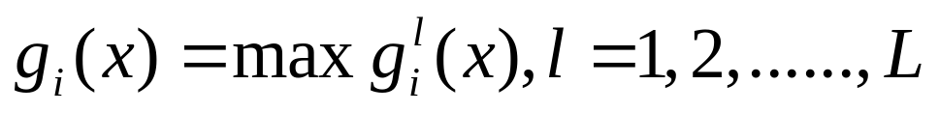
5.1.2. Function Based Piecewise Linear Discriminant method
The second step: Searching the largest discriminant function from each l sub-class in the i^{th} class, and taking this discriminant function as the representative discriminant function of the corresponding class:

Slide 12
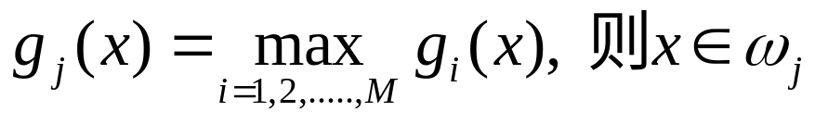
5.1.2. Function Based Piecewise Linear Discriminant method
The third step: The test point x is considered as the j^{th} class which has the maximun, and the corresponding discriminant function is selected as the largest discriminant function:

Slide 13
5.1. Non-linear discriminant method
1. Introduction of Non-linear discriminant method
2. Piecewise Linear Discriminant method
  Distance Based Piecewise Linear Discriminant method
  Function Based Piecewise Linear Discriminant method
3. Quadratic discriminant method

Slide 14
5.1.3. Quadratic discriminant method
QDA is a variant of LDA in which a single covariance matrix is estimated for each type of observation.
QDA is particularly useful if you know in advance that individual categories exhibit different covariances.

Slide 15
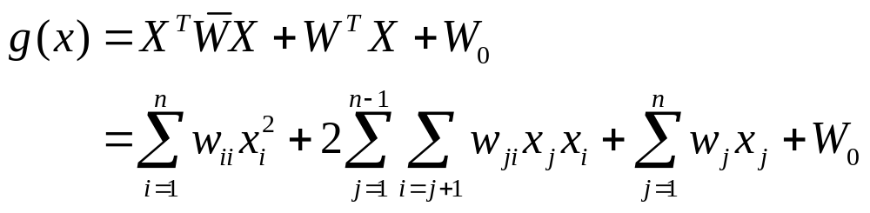


5.1.3. Quadratic discriminant method
The form of Quadratic discriminant function is :
Where is the nxn weighted matrix, and the weighted vector.

Slide 16
Chapter 6 non-linear discriminant function and neighbor classifier
Chapter 5: Non-linear discriminant method and BPNN
Non-linear discriminant method
Back propagation neural network

Slide 17
5.2 Back propagation neural network(BPNN)
Introduction of NN
Introduction of BPNN
Parameter training
Application

Slide 18
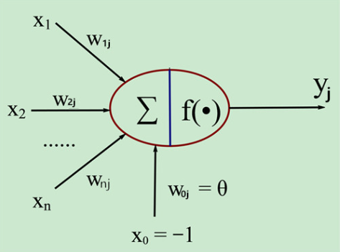
5.2.1 Introduction of NN
M-P model is actually to simulate the structure of single neuron in human brain

Slide 19
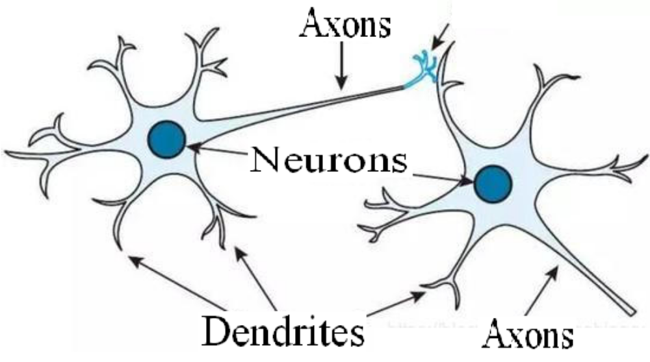
5.2.1 Introduction of NN

Slide 20
5.2 Back propagation neural network(BPNN)
Introduction of NN
Introduction of BPNN
Parameter training
Application

Slide 21
5.2.2 Introduction of BPNN
Three elements of BPNN:
  1) Network topology
  2) Activation function
  3) learning algorithm

Slide 22
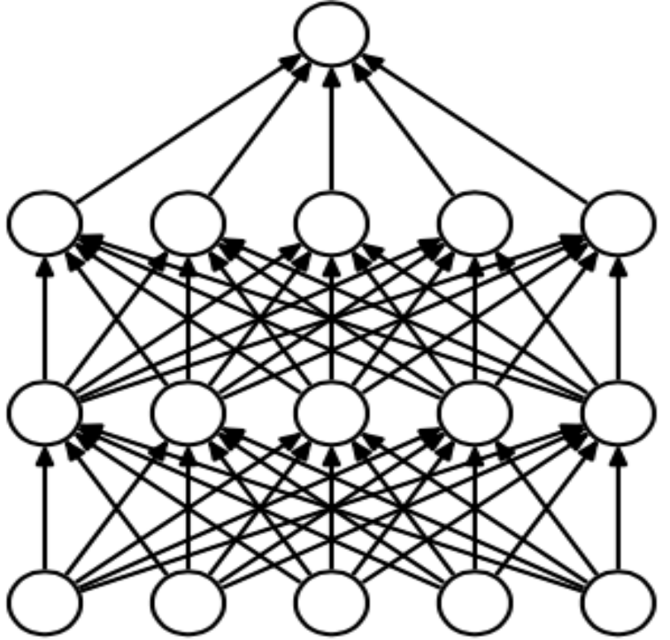
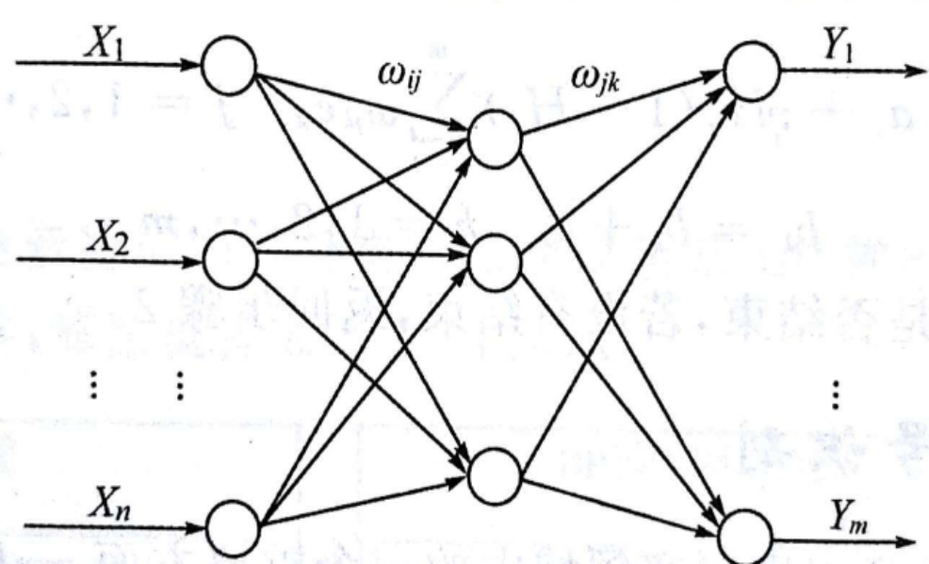
Network topology of BPNN
BP network is actually a multilayer perceptron, so its topological structure is the same as that of multilayer perceptron.

Slide 23
5.2.2 Introduction of BPNN
Three elements of BPNN:
  1) Network topology
  2) Activation function
  3) learning algorithm

Slide 24
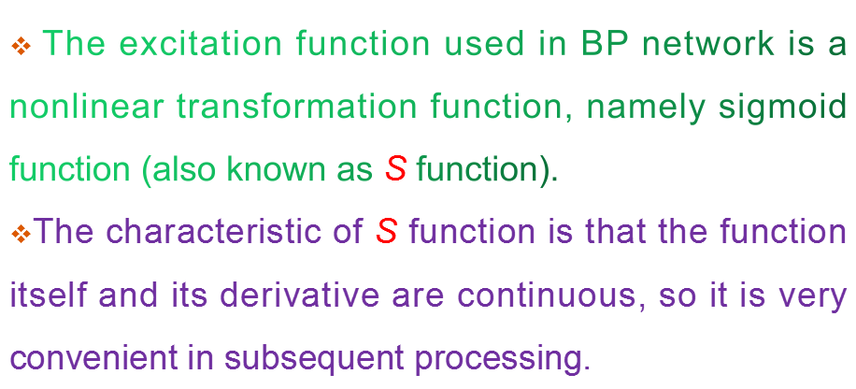
Activation function of BPNN

Slide 25
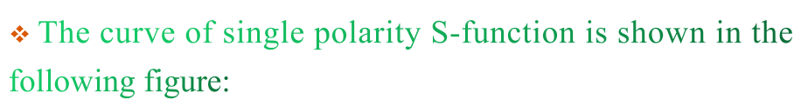
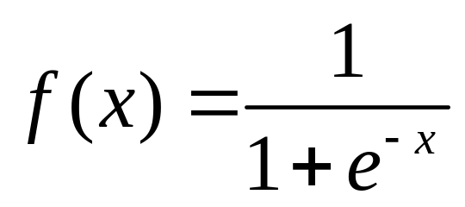
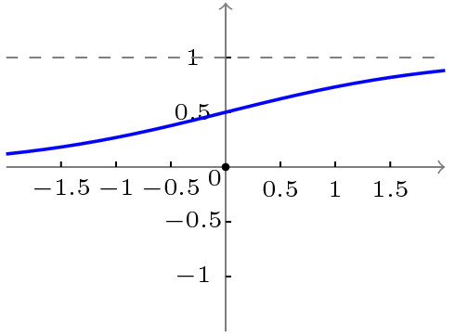
Activation function of BPNN

Slide 26
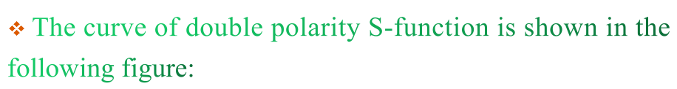
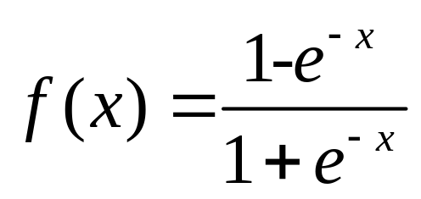
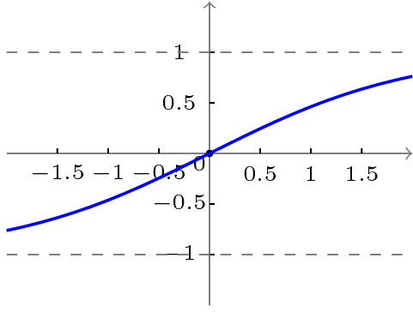
Activation function of BPNN

Slide 27
5.2.2 Introduction of BPNN
Three elements of BPNN:
  1) Network topology
  2) Activation function
  3) learning algorithm

Slide 28
learning algorithm
In BP learning algorithm, the weight adjustment formula of each layer is the same in form, which is determined by three factors:
  Learning rate
  Error signal output by this layer
  Input signal of this layer

Slide 29
5.2 Back propagation neural network(BPNN)
Introduction of NN
Introduction of BPNN
Parameter training
Application

Slide 30
5.2.3 Parameter training of BPNN
The training process of BP neural network is divided into two parts:
Forward transmission: transmitting the output value of each layer in turn;;
Backward feedback: adjusting the weight and bias of each layer in reverse order.

Slide 31
5.2.3 Parameter training of BPNN
The termination conditions of BP neural network training:
Set the maximum number of iterations, for example, stop training after 100 iterations;
Calculate the prediction accuracy of training set, and stop training after reaching a pre-set threshold.

Slide 32
5.2 Back propagation neural network(BPNN)
Introduction of NN
Introduction of BPNN
Parameter training of BPNN
Application of NN

Slide 33
Application of NN
Application of NN in Multi-Media field:
Speech recognition
Handwritten character recognition
Object recognition and face recognition

Slide 34
Application of NN
Application of NN in other fields:
Sport field: AlphaGo
Power field: Google DeepMind
Military field: unmanned aerial vehicle
Medical field: DNA analysis, cancer prediction
Intelligent manufacturing field: Mechanical arm, accurate grasp of unseen objects

